Slide 1
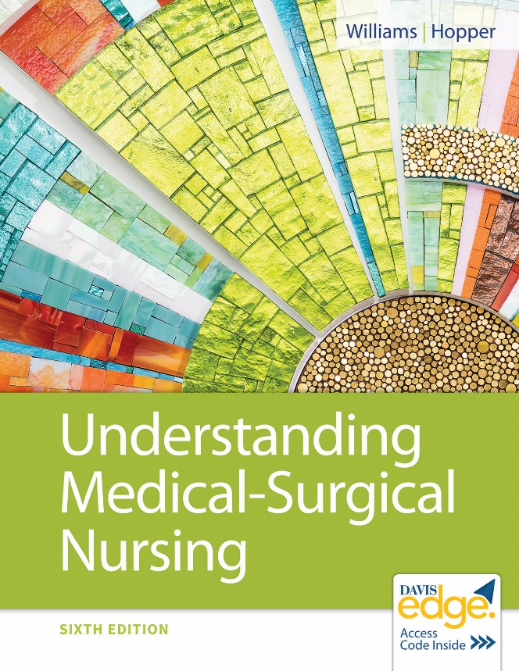
Chapter 20
Nursing Care of Patients with
HIV Disease and AIDS

Slide 2
Learning Objectives
Define human immunodeficiency virus (HIV) and acquired immunodeficiency syndrome (AIDS).
Explain how HIV is transmitted.
Explain tests for diagnosing HIV.
Describe the prognosis for HIV and AIDS.
Develop a teaching plan for prevention of an HIV infection.

Slide 3
Learning Objectives (continued)
Identify prevention measures used to decrease infection and opportunistic diseases for patients with HIV.
Develop a teaching plan for a patient with HIV receiving antiretroviral therapy.
Plan nursing care for patients with HIV and AIDS related to medications, coinfection prevention, and maintaining nutritional status.

Slide 4
HIV
Chronic infection with treatment
Sometimes progressive immune disorder
HIV untreated results in AIDS over time.

Slide 5
AIDS
Final stage of HIV infection
No cure
Can be fatal

Slide 6
Incidence
2015
1.1 million infected with HIV
15% unaware of infection status
2016
39,782 newly infected with HIV
45% African Americans (highest %)
19% women (declining)

Slide 7
HIV Subtypes
HIV-1
Primary type
Worldwide
HIV-2
Primarily West Africa

Slide 8
HIV Pathophysiology: 7 Steps
Binding: CD4 receptor of host cell
Fusion: Membranes fuse
Reverse transcriptase: Viral RNA to DNA
Integrase: HIV DNA into host cell DNA
Replication: Host cell makes HIV proteins
Packaging: Viral envelope for new HIV
Budding: Release and protease cutting of HIV proteins

Slide 9
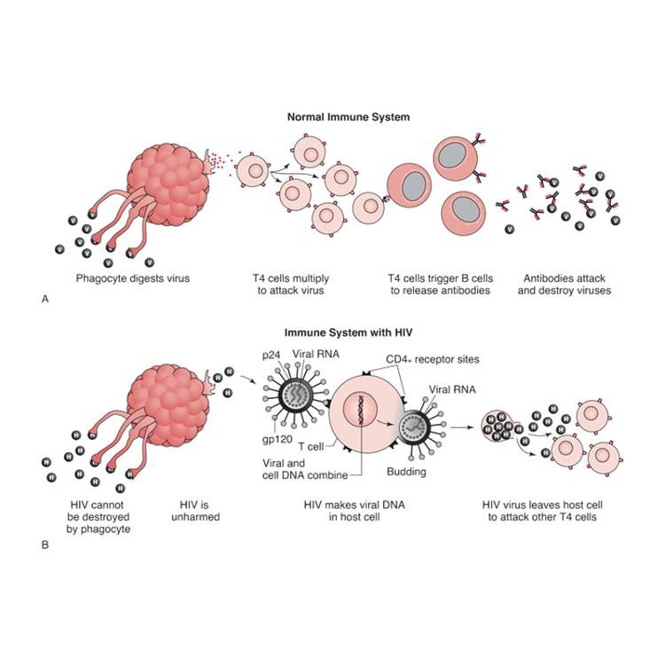
H I V Pathophysiology: 7 Steps (continued)

Slide 10
Antiviral Drugs and the 7 Steps
Binding: Cellular chemokine receptor type 5 (CCR5) antagonists block attachment
Fusion: Fusion inhibitors
Reverse transcriptase: Stopped by non-nucleoside reverse transcriptase inhibitors (NNRTI’s), nucleoside reverse transcriptase inhibitors (NRTI’s)

Slide 11
Antiviral Drugs and the 7 Steps (continued)
Integrase: Integrase inhibitors
Replication: Prevented by NNRTI’s, NRTI’s
Packaging
Budding: Protease inhibitors

Slide 12
HIV Progression
Initial infection
Clinical latency: Symptom-free period
CD4 T lymphocytes decreasing
8 to 12 years until symptoms of HIV
Symptoms are of weakening immune system

Slide 13
HIV Progression (continued_1)
AIDS
CD4 T lymphocytes less than 200 cells/microliter
CD4 T lymphocyte less than 14% of total lymphocytes
Opportunistic infections/cancers

Slide 14
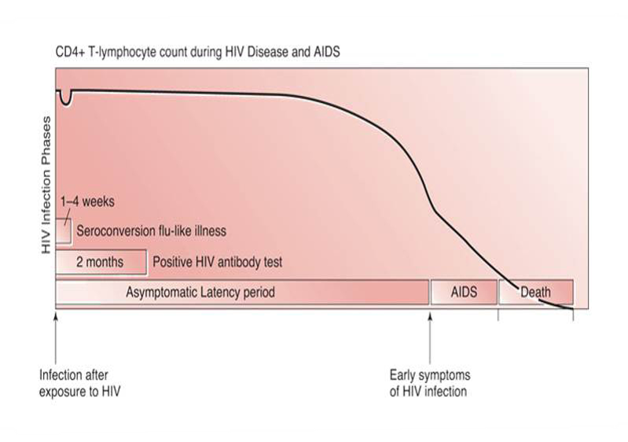
HIV Progression (continued_2)

Slide 15
HIV Prevention
Prevention/education to manage epidemic
Centers for Disease Control and Prevention (CDC) recommendation
Teach all ages from older children through older adults.

Slide 16
Older Adults and HIV
2014: 17% over age 50
Diagnosed late when AIDS present
Less likely to
Be tested for HIV
Use condoms
Increased risk from aging immune system
Women at increased risk

Slide 17
HIV Mode of Transmission
Through HIV-infected
Blood
Breast milk
Semen
Vaginal secretions
HIV not spread casually

Slide 18
HIV Routes of Transmission
Sexual
Parenteral
Perinatal

Slide 19
Pre-Exposure Prophylaxis (PrEP)
Effective prevention for those at high risk
Antiretroviral drug
Emtricitabine/tenofovir disoproxil (Truvada)
Daily pill
Take consistently
Used with other transmission precautions

Slide 20
HIV Counseling/Testing
Per CDC guidelines
Routine testing for 15 to 65 years old, pregnant females or after sexual assault
Confidentially/anonymously
Post-test counseling by trained personnel
Explain test results.
Assist with informing sexual partners/drug needle sharers.
Discuss risk factor reduction.
Give care options.

Slide 21
HIV Sexual Transmission
Highest risk
Anal sex
Greater risk to women
HIV infection reduced with PrEP
Early treatment reduces transmission to uninfected partners 96%

Slide 22
Safer Sex Practices
Abstinence
Monogamous sexual relationship
Limit sexual partners
Condoms
Dental dams
Latex gloves

Slide 23
Parenteral Transmission
Injection drug use
Avoid
Do not share drug injection equipment.
Clean equipment if won’t stop sharing.
PrEP reduces transmission risk.
Autologous blood transfusions
Reduces risk

Slide 24
Perinatal Transmission Prevention
Routine testing during prenatal care
Repeat in third trimester for high risk
If HIV positive, antiretroviral therapy
Pregnancy, labor, delivery
Infant given Zidovudine for 6 weeks

Slide 25
Prevention for Health Care Workers
Hand hygiene
Personal protective equipment
Standard precautions
Needle sticks
No recapping of needles
Needleless system
Needle safety devices

Slide 26
Postexposure Prophylaxis Guidelines
Urgent medical condition
Wash exposure site with soap/water.
Mucous membrane exposure, flush with water.
Consider risk.
Test source.
Treatment for 28 days
Begin within hours of exposure.

Slide 27
After HIV Infected
Signs and symptoms 6 to 12 weeks
Fatigue
Headache
Fever
Lymphadenopathy
Diarrhea
Sore throat

Slide 28
Late HIV Infection Phase
Signs and symptoms
Shortness of breath
Weight loss
Night sweats
Persistent diarrhea
Oral/vaginal candidiasis
Dry skin, skin lesions
Peripheral neuropathy
Shingles
Seizures
Dementia

Slide 29
Final Stage of HIV Infection
AIDS diagnosis
C D4 T lymphocyte count less than 200 cells/microliter
OR
Opportunistic infections and diseases
CDC defined

Slide 30
Complications
AIDS wasting syndrome
Weight loss more than 10%
Plus for more than 30 days
Chronic weakness or fever
OR
Chronic diarrhea

Slide 31
Complications (continued_1)
AIDS dementia complex
Memory impairment
Personality changes
Hallucinations
Loss of balance
Slow responses
Safety important

Slide 32
Complications (continued_2)
Opportunistic infection
Candida albicans
Cytomegalovirus
Pneumocystis pneumonia
Tuberculosis
Other
Cancer
Kaposi sarcoma (rarely seen with therapy)

Slide 33
Diagnosis
HIV antigen/antibody combination test
Nucleic acid test
Complete blood count/lymphocyte count
C D4 T lymphocyte count
Viral load testing
Genotyping

Slide 34
HIV Antigen/Antibody Testing Pattern
HIV antigen/antibody combination immunoassay
HIV antibody immunoassay differentiation test for HIV-1 and HIV-2
HIV-1 nucleic acid test

Slide 35
C D4 T Lymphocyte Count
Initial evaluation of status of immune system
Identifies need for antiretroviral therapy
Normal: 332 to 1,642 cells/microliter
In HIV levels drop
Monitor during antiretroviral therapy

Slide 36
Viral Load Testing
Measures amount of HIV RNA in plasma
Shows response to antiretroviral therapy
Within 1 month of antiretroviral therapy
Then 3 to 4 month intervals for 2 years
Then every 6 months if virus suppressed
Goal: Ultra-sensitive undetectable viral load

Slide 37
Genotyping
Measures resistance to current antiviral treatments
Guides treatment regimens

Slide 38
General Testing
Syphilis
Hepatitis A, B, C
Liver chemistry panels

Slide 39
Therapeutic Interventions
No cure
Begin antiretroviral therapy (ART)
Goal of therapy
Prevent/delay opportunistic diseases

Slide 40
Prophylactic Intervention
Hepatitis A, B
Herpes simplex
Microbacterium avium complex
Pneumocystis pneumonia

Slide 41
Antiretroviral Therapy (ART)
Early, aggressive treatment
Each drug class acts on different stage of HIV life cycle
Multiple drug therapy
Three drugs in at least two classes of treatment categories
Reduces viral load to undetectable level
Prolongs survival

Slide 42
ART Drugs
CCR5 antagonists
Block CCR5 receptor that opens host cell door to prevent HIV-1 entry into CD4 cells
Fusion inhibitors
Block HIV fusion with CD4 cell membrane
NRTI’s
Block HIV reverse transcriptase
Inhibit reverse transcriptase/viral replication

Slide 43
ART Drugs (continued)
Integrase inhibitors
Block HIV from combining with its genetic code
Protease inhibitors
Bind to active site of HIV protease enzyme
Interrupt formation of viral particles

Slide 44
Nursing Diagnoses
Ineffective Protection
Ineffective Coping
Risk for Injury
Deficient Knowledge
Impaired Gas Exchange
Diarrhea
Fatigue

Slide 45
Nursing Diagnoses (continued)
Imbalance Nutrition: Less Than Body Requirements
Impaired Oral Mucous Membrane Integrity
Acute or Chronic Pain
Impaired Skin Integrity
Risk for Situational Low Self-Esteem
Social Isolation

Slide 46
Nursing Intervention
Ineffective protection
Hand hygiene/bathing
Avoid sharing grooming items.
Wash toothbrush.
Use clean dishes.
Report infection symptoms.

Slide 47
Nursing Intervention (continued_1)
Acute or chronic pain
Identify cause.
Medications
Complementary therapy
Heat/cold
Massage
Positioning
Fatigue
Alternate activity and rest.
Prioritize activity timing.

Slide 48
Nursing Intervention (continued_2)
Imbalanced nutrition
Identify interfering factors.
Weigh.
Monitor caloric intake.
Consult dietitian.
Have patient eat small, frequent meals.
Use antiemetics.

Slide 49
Review Question
The nurse would recognize the need for further teaching about HIV if the patient stated which of the following about HIV? Select all that apply.
“HIV is an acute infection.”
“It can be a progressive immune disorder.”
“Over time, HIV can cause AIDS.”
“HIV is curable.”
“ART increases HIV replication.”

Slide 50
Review Question Answer
Correct Answer: 1, 4, 5

Slide 51
Review Question (continued_1)
The nurse is assisting with education at a health fair. Which of these would the nurse include as modes of transmission for HIV?
Select all that apply.
Men who have sex with men
Heterosexual contact
Handshaking
Injection drug use
Sharing dishes and eating utensils

Slide 52
Review Question Answer (continued_1)
Correct Answer: 1, 2, 4

Slide 53
Review Question (continued_2)
The nurse is assisting with education at a health fair. Which of these would the nurse include as sources of exposure to HIV?
Select all that apply.
Blood
Semen
Tears
Vaginal secretions
Breast milk

Slide 54
Review Question Answer (continued_2)
Correct Answer: 1, 2, 4, 5

Slide 55
Review Question (continued_3)
Which of the following would the nurse include when teaching about PrEP?
Select all that apply.
Prevention for those at high risk
Antiretroviral drug
Weekly injection
Other transmission precautions not needed
Daily pill

Slide 56
Review Question Answer (continued_3)
Correct Answer: 1, 2, 5

Slide 57
Review Question (continued_4)
The nurse experiences a needle stick. Which of these actions should the nurse take?
Select all that apply.
Wash exposure site with soap/water.
Seek urgent medical care.
Flush mucous membranes with water.
Begin ordered therapy within hours after exposure.
Follow treatment for 1 week.
Test source.

Slide 58
Review Question Answer (continued_4)
Correct Answer: 1, 2, 4

